Slide 1
HEMATOLOGIC CHANGE DUE TO COVID19
DR.cHavoshi

Slide 2
During the incubation period, usually ranging from 1 to 14 days, and during the early phase of the disease, when non-specific symptoms are present, peripheral blood leukocyte and lymphocyte counts are normal or slightly reduced
Following viremia, SARS-CoV-2 primarily affects the tissues expressing high levels of ACE2 including the lungs, heart and gastrointestinal tract. Approximately 7 to 14 days from the onset of the initial symptoms, there is a surge in the clinical manifestations of the disease with a pronounced systemic increase of inflammatory mediators and cytokines, which may even be characterized as a “cytokine storm”. At this point, significant lymphopenia becomes evident

Slide 3
The most common hematological findings include lymphocytopenia, neutrophilia , eosinopenia, mild thrombocytopenia and, less frequently, thrombocytosis. The presence of reactive lymphocytes has been reported only occasionally. The leukocyte count may be normal, reduced or increased.
Leukocytosis, lymphopenia and thrombocytopenia are associated with greater severity and even fatality in COVID-19 cases.

Slide 4
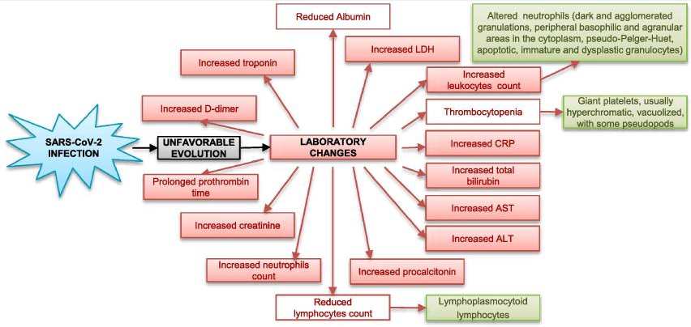

Slide 5
lymphopenia
It has been shown that lymphocytes express the ACE2 receptor on their surface;9 thus SARS-CoV-2 may directly infect those cells and ultimately lead to their lysis.
The cytokine storm is characterized by markedly increased levels of interleukins (mostly IL-6, IL-2, IL-7, granulocyte colony stimulating factor, interferon-γ inducible protein 10, MCP-1, MIP1-a) and tumor necrosis factor (TNF)-alpha, which may promote lymphocyte apoptosis.
Substantial cytokine activation may be also associated with atrophy of lymphoid organs, including the spleen, and further impairs lymphocyte turnover.
Coexisting lactic acid acidosis, which may be more prominent among cancer patients who are at increased risk for complications from COVID-19,14 may also inhibit lymphocyte proliferation
The RECOVERY trial gained much attention when it found an 8–26% lower mortality among patients who received 6 mg/day of dexamethasone for up to 10 days

Slide 6
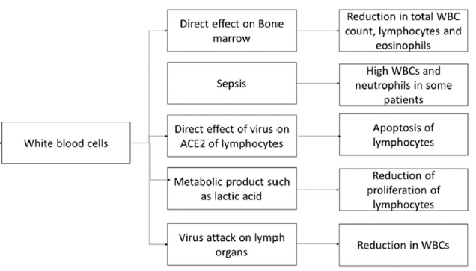

Slide 7
thrombocytopenia
The potential reasons for thrombocytopenia include direct effect of SARS-CoV-2 on platelet production, autoimmune destruction of platelets, or increased platelet consumption. Secondary hemophagocytic lymphohistiocytosis causes excessive proliferation and activation of macrophages, and in turn produces a surge in inflammatory cytokines. It has been postulated this cytokine storm damages hematopoietic progenitors and reduces platelet Production
As severe thrombocytopenia is not common in COVID-19 patients, treatment of this aspect is usually not needed

Slide 8
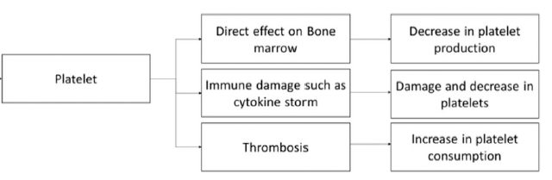

Slide 9
RED CELL AND HEMOGLOBIN ABNORMALITIES
IN COVID-19
A meta-analysis of four studies found hemoglobin concentrations to be lower in severe disease than in mild infections.
A few studies found no significant changes in hemoglobin levels in COVID-19 patients.
No significant effects on red blood cell (RBC) counts have been found, but structural changes have been noted.
Although anemia has been reported in some patients, no studies have shown transfusion support for this indication alone, to improve outcomes. Patients with hemoglobinopathies and COVID-19 should continue to receive transfusions and chelation therapy as needed

Slide 10
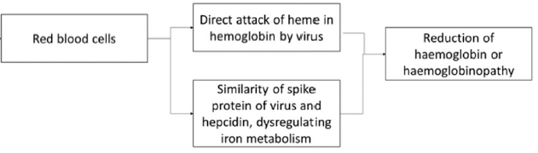

Slide 11
EFFECTS ON THE BONE MARROW
Hemophagocytosis has been noted in the bone marrow aspirates of three severe COVID-19 patients.
There was an increase in pleomorphic megakaryocytes, plasma cells, macrophages, and hemophagocytosis

Slide 12
EFFECTS ON THE SPLEEN
The angiotensin-converting enzyme-2 (ACE-2) receptor is expressed in the spleen, at lower concentrations than in the lung, heart, and intestines
On postmortem examination of six COVID-19 patients, ACE-2 was found to be expressed in the splenic red pulp and medulla of lymph nodes
Angiotensin-converting enzyme-2 receptors were also expressed on CD68 and CD169 macrophages in the spleen and lymph nodes.
Decrease in T and B lymphocytes, a reduction and atrophy of lymphoid follicles, atrophy of the white pulp, and neutrophil/plasma cell infiltration
Reduced number of lymphocytes and cell degeneration/necrosis in the spleen. These may have an impact on immune cells, particularly a decrease in lymphocytes

Slide 13
Coagulation Complications
D-dimer elevation and DIC may be common in patients with severe form of COVID-19 infection
The median time from admission to DIC manifestation was 4 days (range: 1-12 days)
The antiviral inflammatory response may shift the balance in the anticoagulant and procoagulant pathways, leading to altered coagulation.
von Willebrand Factor (VWF) is a procoagulant that is released in the presence of endothelial cell damage and has been found to be elevated in COVID-19
The routine use of antithrombotic prophylaxis with low-molecular-weight heparin is recommended for inpatients by the International Society on Thrombosis and Hemostasis

Slide 14
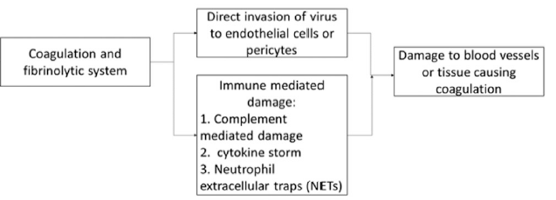

Slide 15
The emerging role of biomarkers procalcitonin, ferritin and C-reactive protein in the prognosis
Increased LDH has been associated also with higher risk of ARDS, ICU support and death
Higher CRP has been linked to unfavorable aspects of COVID-19 disease, such as ARDS development, higher troponin-T levels and myocardial injury, and death
increased procalcitonin values were associated with a nearly 5-fold higher risk of severe infection
higher serum ferritin was associated with ARDS development

Slide 16
Red blood cell disorders
In general, patients with sickle cell disease (SCD) and thalassemia have a higher risk for developing infections (especially respiratory tract infections).
Hydroxycarbamide, a commonly used medication in SCD, has immunosuppressive actions, and needs extra care when used
A small study on 11 thalassemia patients did not find an increased severity of COVID-19. It has been hypothesized that patients with heterozygous beta-thalassemia may be protected against COVID-19.

Slide 17
Bleeding and coagulation disorders
In a hemophilia patient, the COVID-19 clinical manifestations were similar to other patients, and there were no bleeding events.
It is not certain if patients with idiopathic ITP or TTP are at increased risk of COVID-19 or if they would get more severe disease.
If the patient is receiving immunosuppressive drugs, extra care may be advisable.

Slide 18
ABO blood groups
A number of studies have suggested an association between ABO blood groups and SARS-CoV-2 infection risk, with group O individuals having a lower risk

Slide 19
TRANSFUSION AND COVID-19
The requirement of transfusions is low in patients with COVID-19 including severe cases. In a retrospective study 13.4% hospitalized COVID-19 patients received transfusions, of which 11% received RBCs and less than 2% received each of the other components such as platelets or plasma. This study showed that hospitalized COVID-19 patients had a lower requirement for transfusions than other hospitalized patients

Slide 20
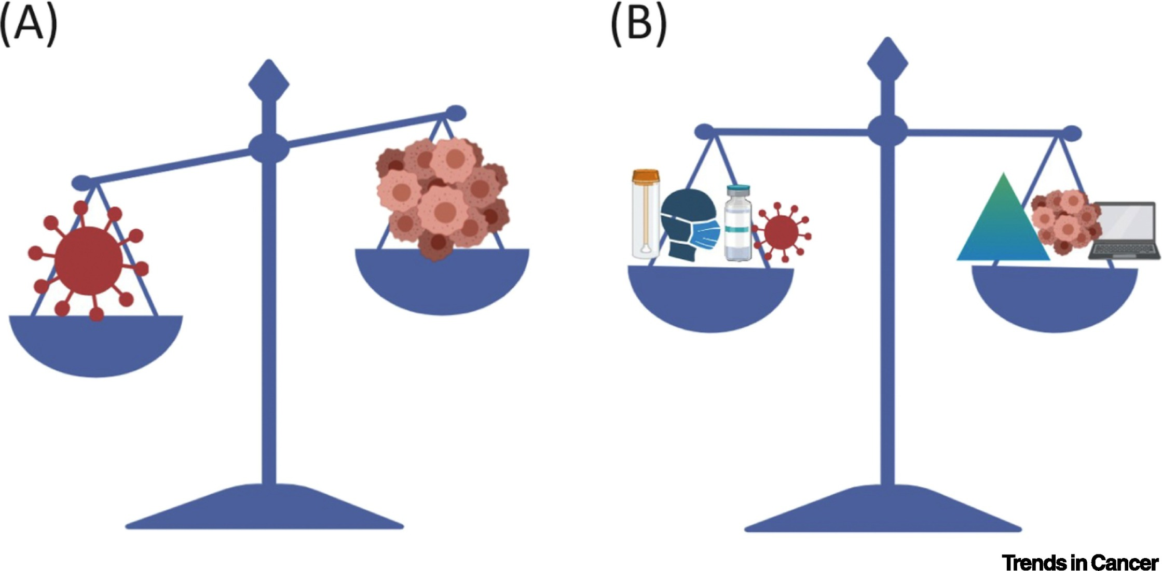

1 Managing Cancer Care during the COVID-19 Pandemic and Beyond
Trends in Cancer 2020 6533-535DOI: (10.1016/j.trecan.2020.04.005)
Copyright © 2020 Elsevier Inc. Terms and Conditions
Notes:
Restoring the Balance for Cancer Care in the Coronavirus Disease 2019 (COVID-19) Era.
(A) COVID-19 challenges the existing paradigm for cancer care. (B) Expanded testing, social distancing, vaccine programs and new therapies for COVID19, telemedicine, and prioritizing certain cancer therapies are suggested modalities to restore the balance of care.

Slide 21
The SKCC approach has also relied heavily on the utilization of outpatient care (including telehealth and home visits) whenever possible, while MNH has opted for an inpatient isolation protocol. We recognize the need to revise and refine these practices as the COVID-19 pandemic evolves, and as we plan for the post-pandemic era of AML care.

Slide 22
Caring for patients with AML during the COVID-19 pandemic has presented unique challenges. However, through the rapid development of a set of overarching principles to guide care, changes in standard practices have been implemented in order to protect patients and staff. At both the SKCC and MNH, these principles have hinged on (1) continued provision of standard AML treatment for patients who are curable or require immediate intervention; (2) deferment of treatment for stable, incurable patients; and (3) delivery of robust supportive care services through innovative mechanisms.

Slide 23
Most people are able to get the COVID-19 vaccine, once supplies allow for their priority group to be vaccinated. But, a few groups of people should not get the vaccine, and some others should consult with their doctor or follow special procedures.
People who should NOT get the COVID-19 vaccine
Anyone with a previous severe or immediate allergic reaction (i.e., one that causes anaphylaxis or requires medical intervention) to a COVID-19 mRNA vaccine dose, a vaccine component, or polysorbate.
Those younger than 16 years of age.
People currently isolating or experiencing symptoms of COVID-19; these people can get vaccinated once they are finished isolation and their primary symptoms have resolved.

Slide 24
People who may get the vaccine after considering risks and benefits and/or consulting with their healthcare provider
Individuals with a history of severe or immediate allergic reaction to any vaccine or injectable medication (These individuals should be observed for 30 minutes after receipt of the vaccine.)
Pregnant women
People with certain immune-compromising conditions
Breastfeeding women
People on anticoagulants

Slide 25
People who should follow special procedures
Someone with a history of severe or immediate allergic reaction (requiring medical intervention) to anything other than a vaccine or injectable medication can get the vaccine, but they should remain at the vaccination location for medical observation for 30 minutes after receipt of the vaccine.
People who recently had COVID-19 and were treated with antibody-based therapies (e.g., monoclonal antibodies or convalescent plasma) should wait until 90 days after treatment to be vaccinated.
People with a known COVID-19 exposure should wait until their quarantine is over before getting vaccinated
People who got another vaccine (non-COVID-19 vaccine) should wait at least 14 days before getting COVID-19 vaccine. Likewise, if a person got the COVID-19 vaccine, they should wait at least 14 days before getting any other vaccines (non-COVID-19 vaccines).

